Slide 1
Anomaly Detection A to Z

Slide 2

Why Listen?
Intro Anomaly Detection
What & Why
Anomaly Detection Methods
Basic
More Complex
Advanced

Slide 3
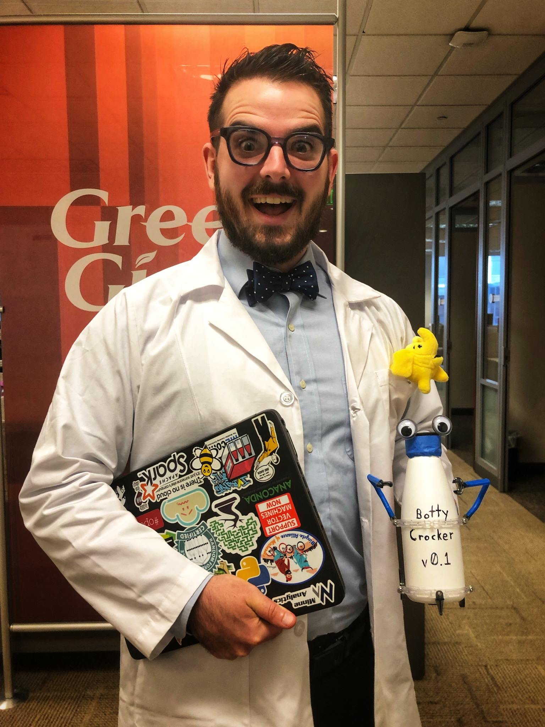
John Hogue
Lead Data Scientist
General Mills
CoFounder
Social Data Science
Executive Advisor
MinneAnalytics

Slide 4
Anomaly
Something that deviates from what is standard, normal, or expected.
Notes:
Pretty much similar definition for outlier

Slide 5
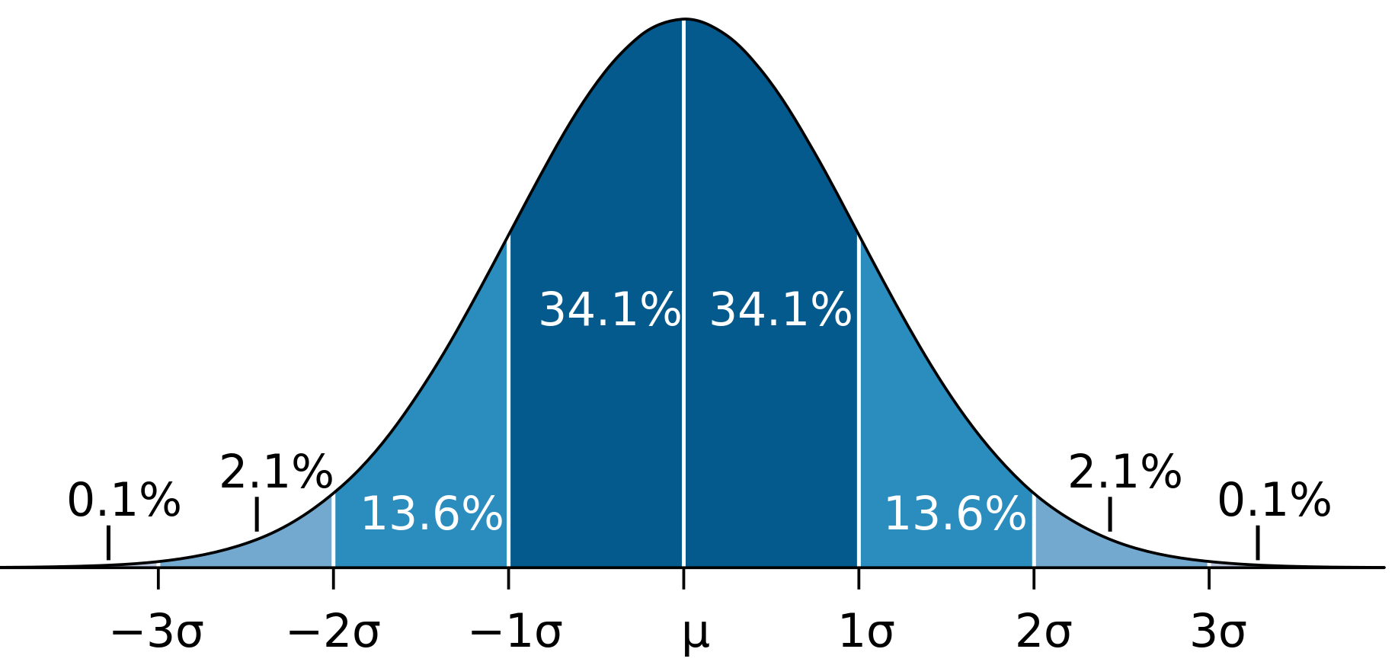
What is ‘standard’, ‘normal’ or ‘expected’?
Mathematically…

Slide 6
Foundational AD methods
Z-Scores
Tukey’s IQR

Slide 7
Plotting IQR

Slide 8

What is ‘standard’, ‘normal’ or ‘expected’?
Contextually…
One’s person’s anomaly is another’s common sense.
Business Acumen decides what is actionable.

Slide 9

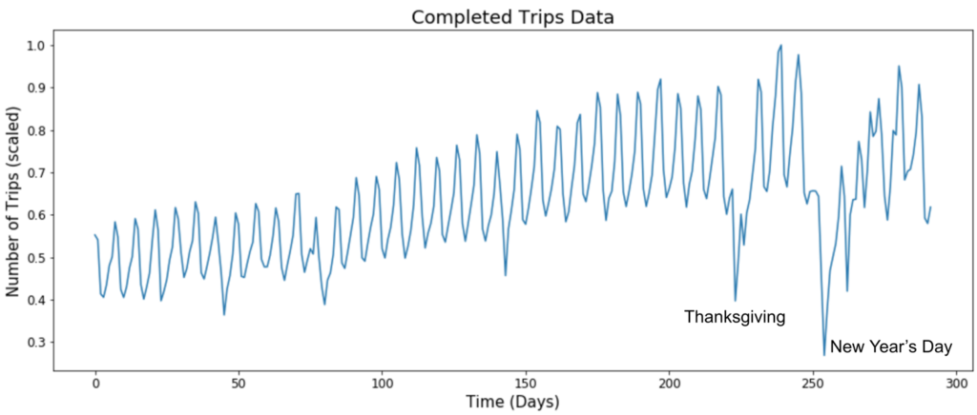
But what about context?

